Slide 1
Sean Koppenhafer, Jaime Rodriguez,
Chad Thueson, Noah Erickson, Rishal Dass
Weekly meeting, 2/25/2015 (Week 8)
Digital Dash
Portland State University
Department of Electrical and Computer Engineering (ECE)
Notes:
1

Slide 2
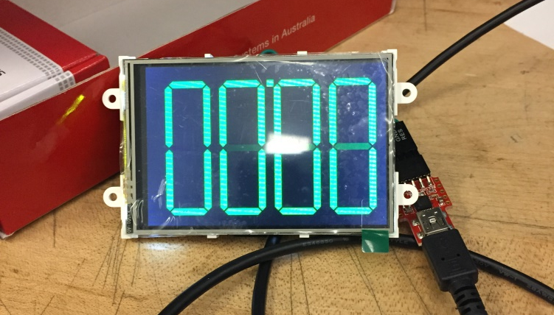

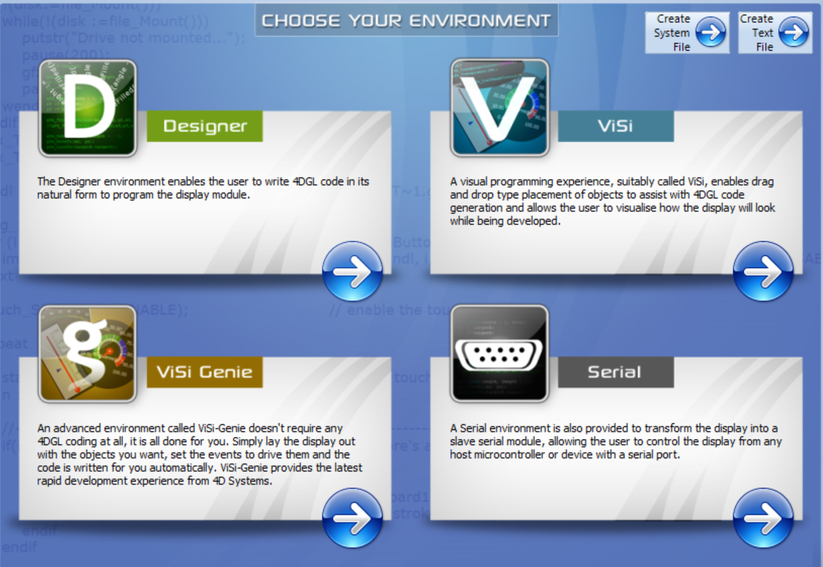
Display Delivered!
Display was delivered Friday
Started learning how to display images on screen
Can place pictures, gauges & digit on screen
Next step is to have it a device send data and display it on screen
May need to code.

Slide 3
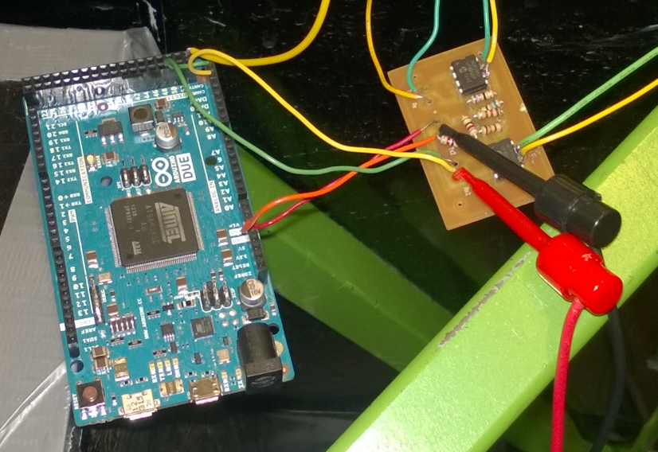
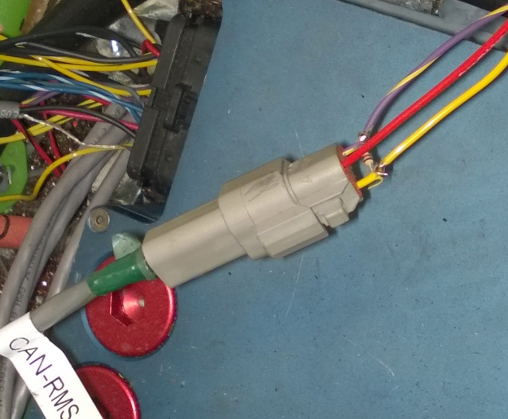
Prototyping Progress
Breakout Board for MCP2551 Transceivers now works.
Layout wiring for Deutsch connectors to work with BMS
Resistance values for BMS CAN network is different from CAN-RMS network.
BMS network needs 180 ohms at each node.
Notes:
3
1/23/15, Thinking about Arduino Due for prototyping, in March send out CAD design for PCB manufacturing to cut down on real estate for the arduino due

Slide 4
Goals for upcoming week
The 4D systems screen
Upload code to display and test
Learn how to work gauges with data being received
Debug Prototype
- Fix Deutsch connectors before Friday
Test Prototype with BMS
Enclosure
Start working on enclosure layouts
Check to see if other screen location is possible

